Slide 1

Embedded system
diploma
Session (1)
Introducton
To
C-programming

Slide 2



introduction to programming
Why C programming ?
C is a structured language which allows a complex program to be broken into simpler programs called functions.
C language has a rich library which provides a number of built-in functions.
Why c-programming language is the best choice in embedded systems?
C can be used for low-level programming, and it also supports functions of high-level programming languages, such as scripting for software applications etc.
C can efficiently work on enterprise applications, games, graphics, and applications requiring calculations, etc.

Slide 3
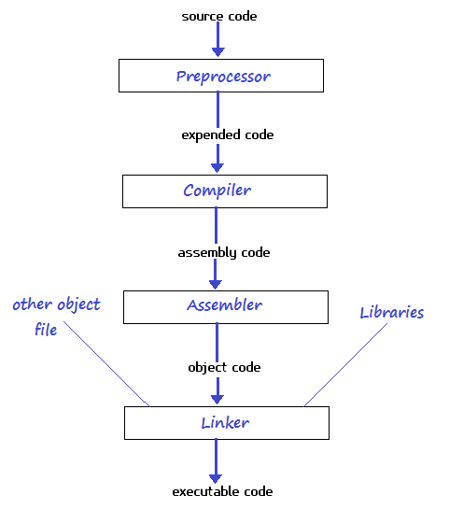
compilation stages
The preprocessor is responsible to convert preprocessor directives into their respective values and generates an intermidate code.
simple.i file is generated.
Expanded source code is sent to compiler which compiles the code and converts it into assembly code.
simple.asm file is generated.
The assembly code is sent to assembler which assembles the code and converts it into object code.
simple.obj file is generated.
The object code is sent to linker which links it to the library such as header files Then it is converted into executable code .
simple.exe file is generated.
The executable code is sent to loader which loads it into memory and then it is executed. After execution, output is sent to console.

Slide 4
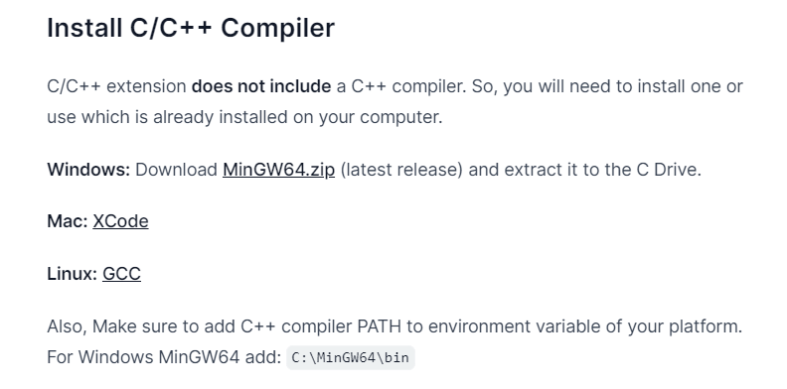
VSC (Visual Studio Code)
https://gourav.io/blog/setup-vscode-to-run-debug-c-cpp-code
https://www.youtube.com/watch?v=G9gnSGKYIg4&ab_channel=VisualStudioCode

Slide 5
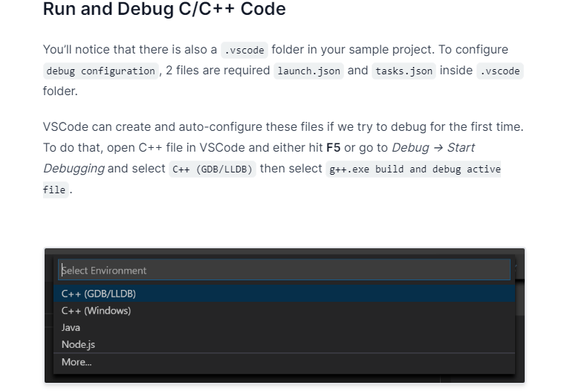
VSC (Visual Studio Code)

Slide 6
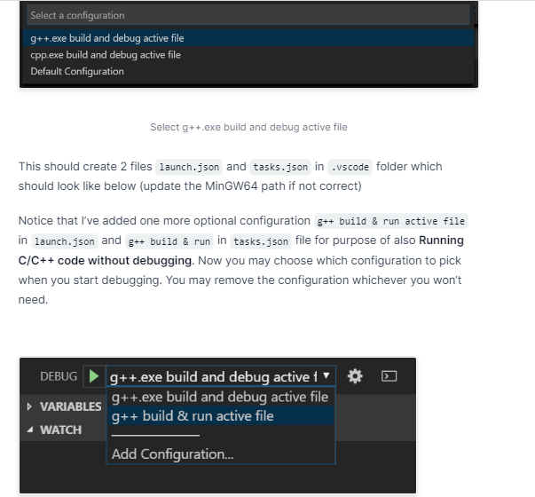
VSC (Visual Studio Code)

Slide 7
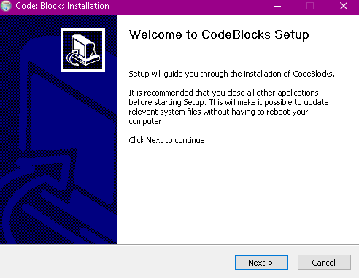
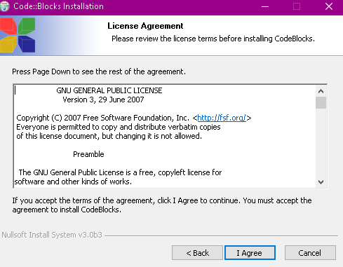
Code blocks installation

Slide 8
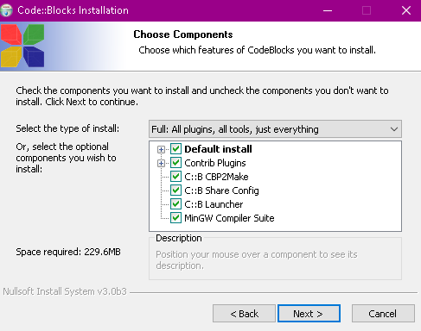
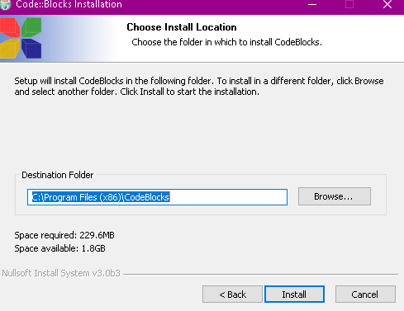
Choose destination folder to install codeblocks

Slide 9
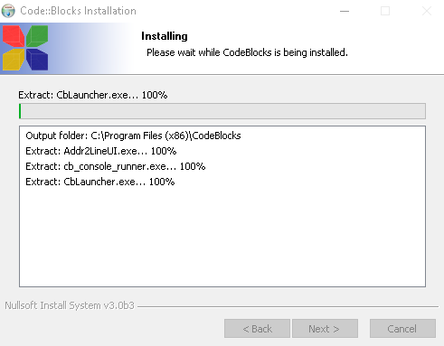
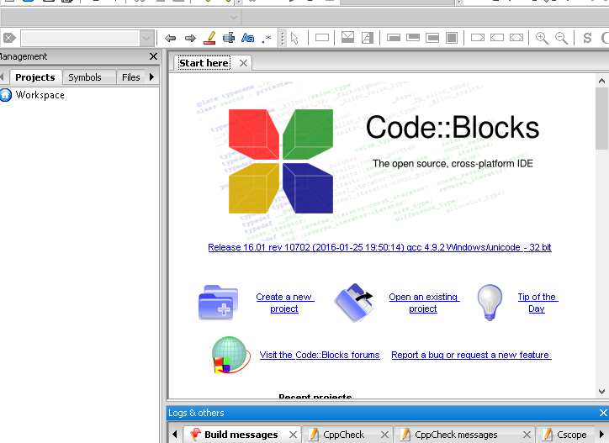
After this process have finished the program will be ready

Slide 10
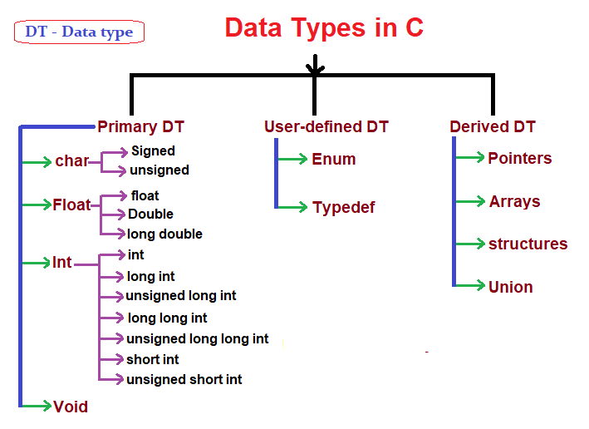
Variables in c
Variable is a part from the memory, used to hold a piece of data.
The variable has a type, name and value.
The types of the variables differs in Size and/or Data to be saved.

Slide 11
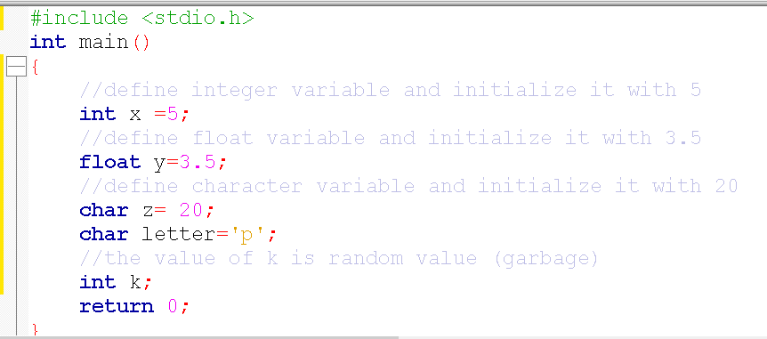
Primary data types
Type name ;
Type name = initial_value ;

Slide 12
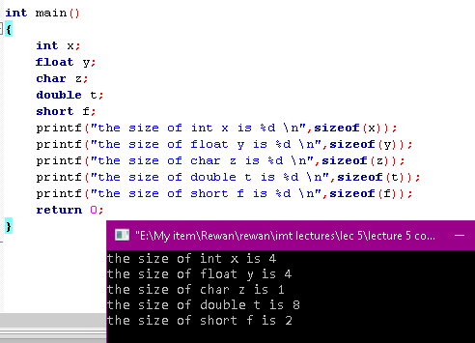
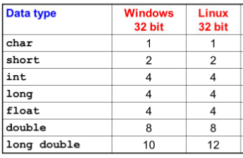
Primary data types
Different data types also have different ranges upto which they can store numbers.
These ranges may vary from compiler to compiler. Below is list of ranges along with the memory requirement and format specifiers on 32 bit gcc compiler.
We can use the sizeof() operator to check the size of a variable in your compiler.

Slide 13
Naming rules of variables
A variable name can only have letters (both uppercase and lowercase letters), digits and underscore.
The first letter of a variable should be either a letter or an underscore.
No Special Symbols other than underscore are allowed, ex ?, #, ….. etc
Blanks & Commas are not allowed
Variable name Should not be Reserved Word .
Variable name can not be repeated in the same scope.

Slide 14
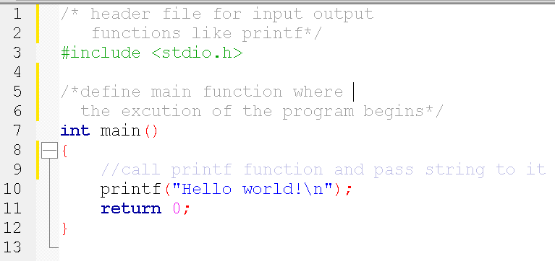

Hello world program
it is the library which contains the prototypes of all the input output functions used in C
it contains only function type signature not the actual implementation.
main() function is the entry point of any C program.
When a C program is executed, the execution control goes directly to the main() function.
Every C program have only one main() function.

Slide 15
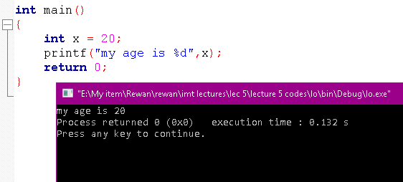
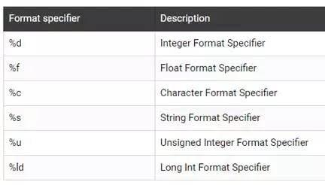
Printf functions
printf() function is used to print the “character, string, float, integer, octal and hexadecimal values” onto the output screen.
printf() function can print a variable inside the string, it could be done by inserting format specifier that will be replaced by the values specified in subsequent additional arguments.

Slide 16
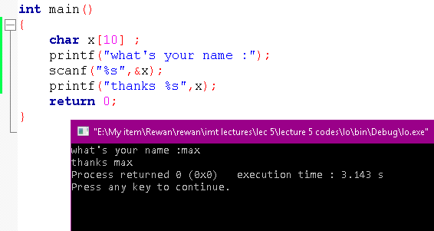
Scanf function
scanf() function is used to read character, string, numeric data from user and save it in a variable
‘&’ is used to get the address of the variable
Where the value scanned from the user will be
Stored in.

Slide 17
Comments and strings
Comments are non-executable text used to provide documentation for the code. It provide clarity to the C source code allowing others to better understand what the code was intended to accomplish.
1- Single-line comment
//this is the single line comment
2- Multi-line comment
/* hi,it’s
a multi line
comment */

Slide 18
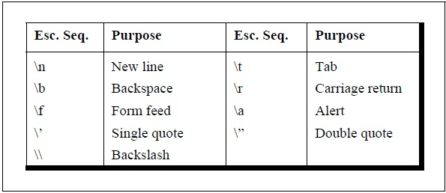

Comments and strings
string is comprised of a set of characters that can also contain spaces, special characters and numbers.
• In C string is represented between double quotation “ This is string “.
• printf function will print the string passed to it as it is.

Slide 19
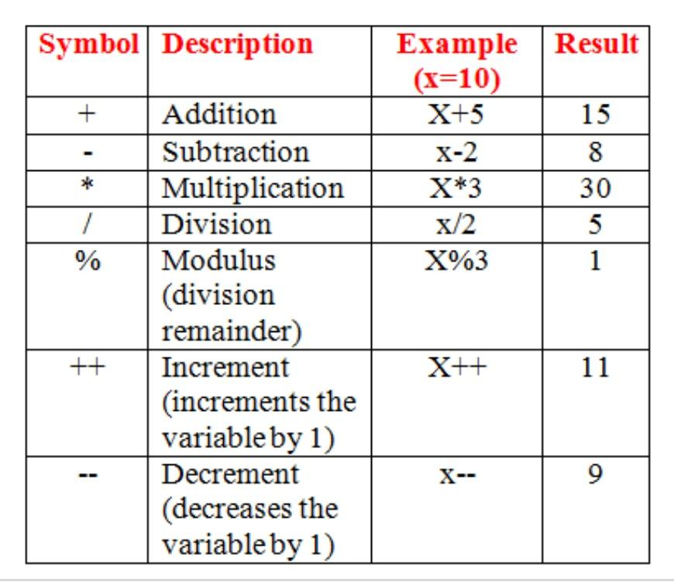
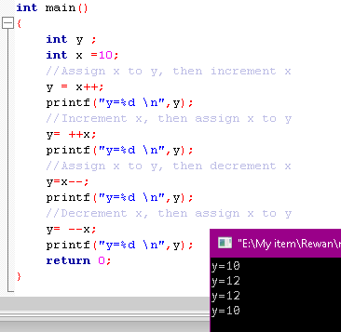

c operations
Arithmetic operations

Slide 20
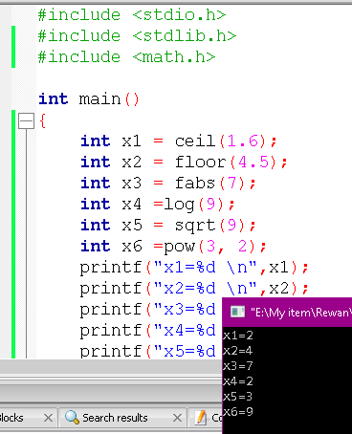

math.h library
The math.h header defines various mathematical functions and one macro.
ceil(x) returns the smallest integer value greater than or equal to x.
floor(x) returns the largest integer value less than or equal to x.
fabs(x) returns the absolute value of x.
log(x) returns the natural logarithm (base-e logarithm) of x.
sqrt(x) returns the square root of x.
pow(x, y) returns x raised to the power of y .

Slide 21
Exercise time
Implement a c program to help a company in make an auto online interview For their applicant Using printf() and scanf() functions.
(questions like name,age,excpected salary , ……….)

Slide 22
Exercise time
Implement a c program to calculate the age of a certain person in years, months, days.

Slide 23
Exercise time
Implement a c program to take two numbers of int data type, two numbers of float data type as input and output :
Sum
Difference
Product
Quotient.

Slide 24
Excirse time
Implement a c program to take two numbers: one of int data type and the other of float data type as inputs and output:
Sum
Difference
Product
Quotient.

